Slide 1
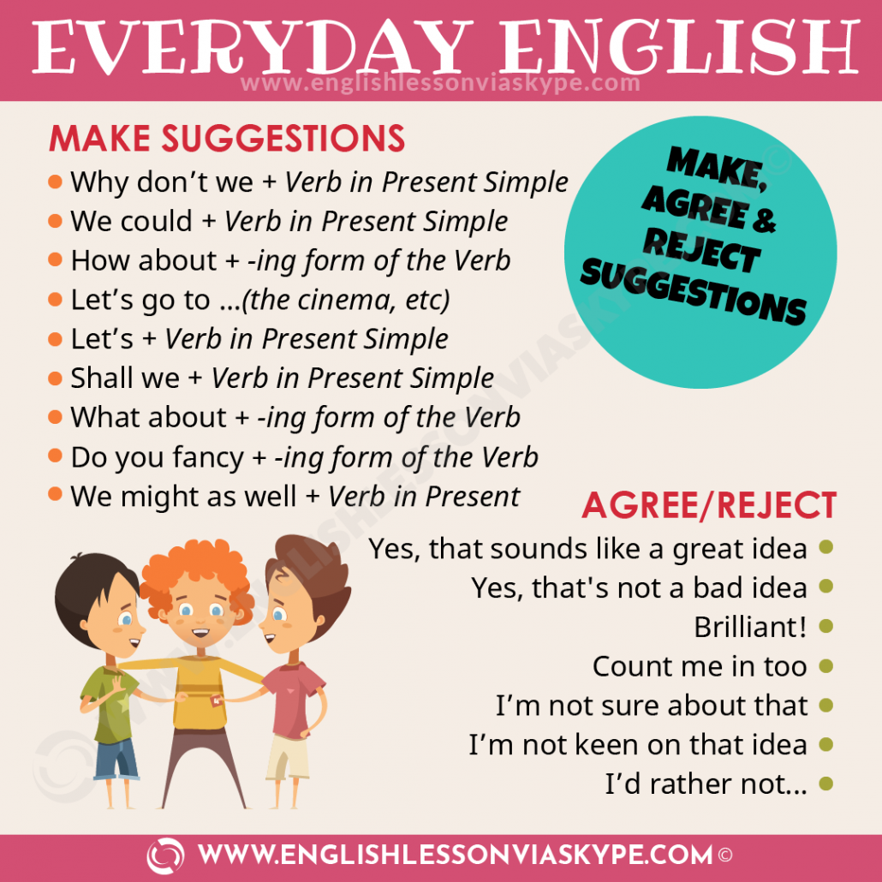

Slide 2
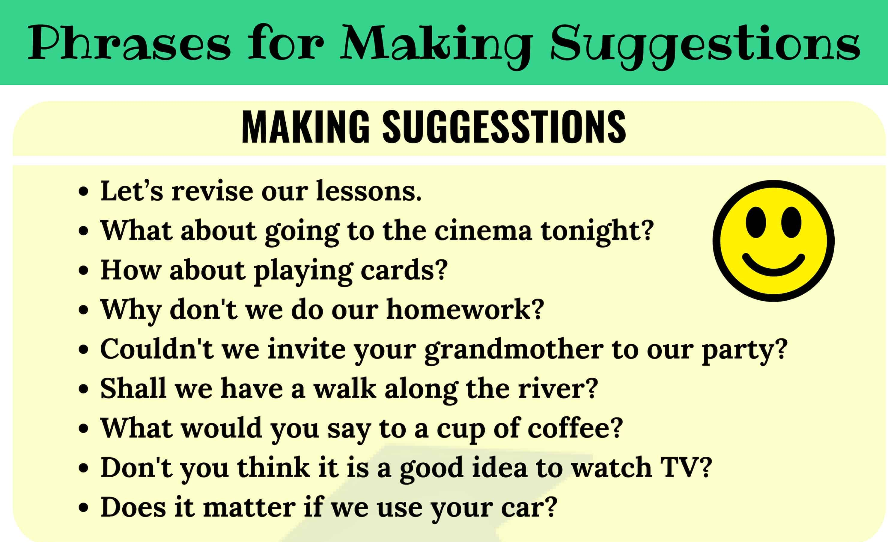

Slide 3
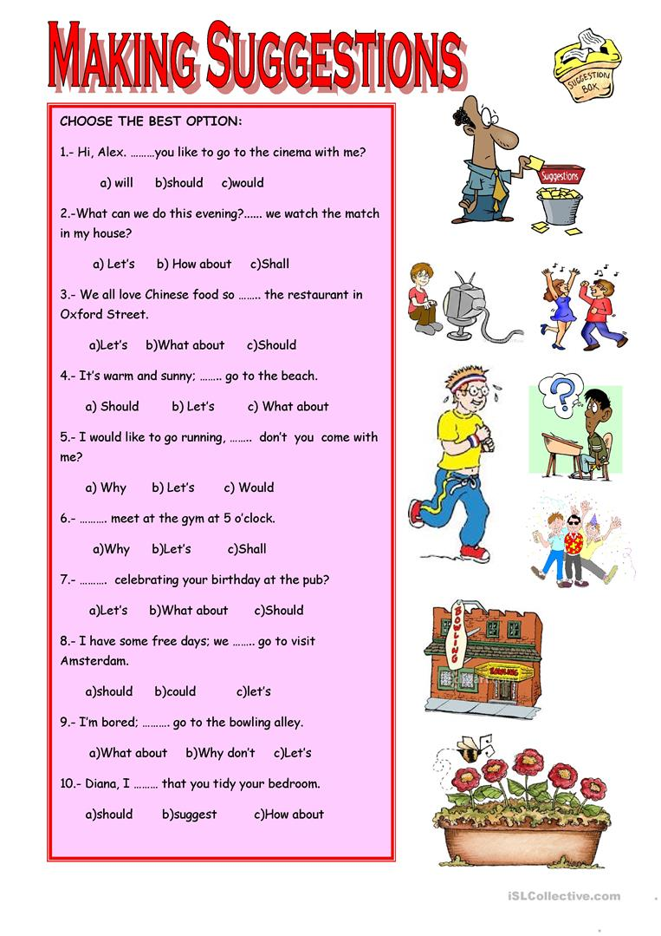

Slide 4
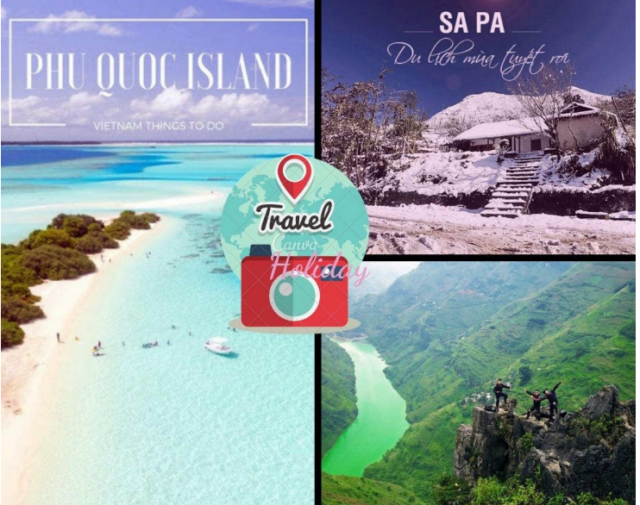
Situation 1:
You and your friend are going to have a long holiday. Work in pair to discuss and
choose an ideal place for travelling. Here is a picture with some ideas to help. (the
picture will be changed in the final Test)
Tây Bắc
Đà Lạt
Nha Trang
Đà Nẵng
Hạ Long
Hà Giang
Hội An
Vũng Tàu
Hà Nội
Mũi Né
……

Slide 5
What kind of holiday do you prefer, beach, sightseeing or adventure holiday?
01
What things do you love doing when you are on holiday?
02
When you travel, do you try to learn about the place, its customs, and its
language? Why/ why not?
03
Situation 1

Slide 6
1.What kind of holiday do you prefer, beach, sightseeing or adventure holiday?
- I prefer beach than sightseeing and adventure because I love to swim in the sea.
- I like to go to the beach because I want to relax on the seashore and swim in the sea.
- I like a beach vacation because I like to see the beauty of the sea, I like to watch the sunset on the sea and enjoy the coolness.
- I like swimming so I prefer going to the beach.
- I prefer to go to the beach because I feel relax and comfortable every time I go there
- I prefer adventure holiday because I can challenge myself, I can see places from new views. It also gives me incredible experiences.

Slide 7
2. What things do you love doing when you are on holiday?
-When I am on holiday. I love going out and having a taste of local street food.
- When I go on vacation, I usually take the time to relax and enjoy the food there.
- I often go to drink coffee and play game on holiday.
- During vacation, I want to explore the place, eat local food and take pictures.
- When I am on holiday, I love travelling, watching films, visiting my relatives and spending times with friends.

Slide 8
3. When you travel, do you try to learn about the place, its customs, and its
language? Why/ why not?
Yes, I do. Because the place , its customs and its language are very useful for travel
Yes, I do. Because it is very interesting
Yes of course because I want to understand more about the customs, the language and much more about the place.
Yes, because it gives me a lot of knowledge.
I will find out because it will make me easier to move and communicate with others
Yes, when I travel to some places, I try to find information about the cultures, languages,the prices, somewhere to visit at there that I can prepare good for the trip.

